Slide 1
Hidden Markov models in marine sciences
Ron Togunov, Marie Auger-Méthé
Notes:
iacam

Slide 2
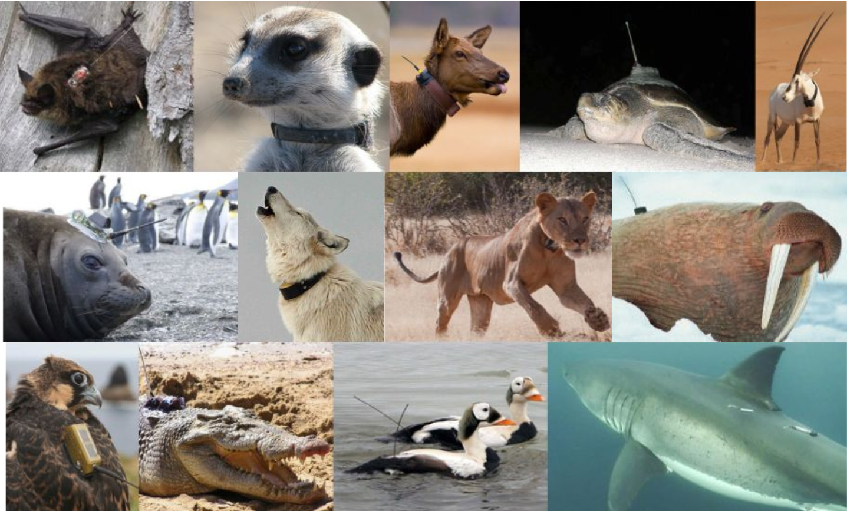

Slide 3
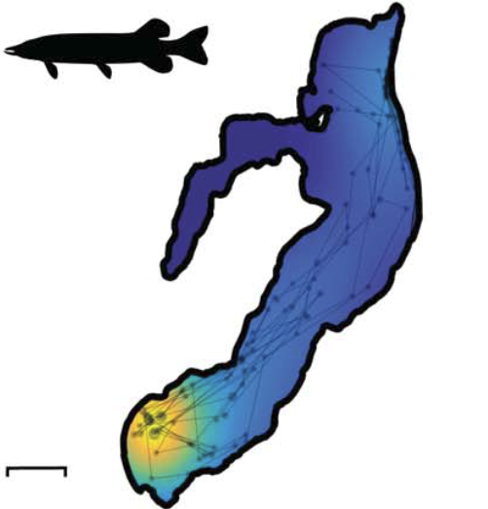
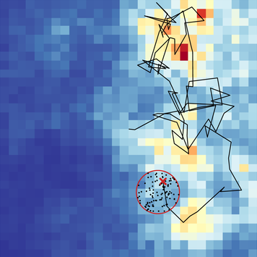
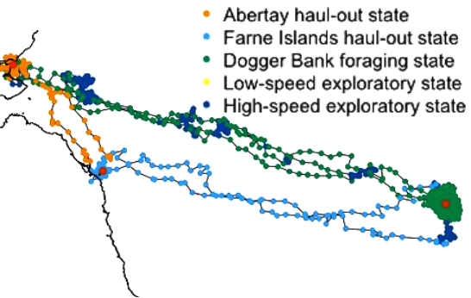
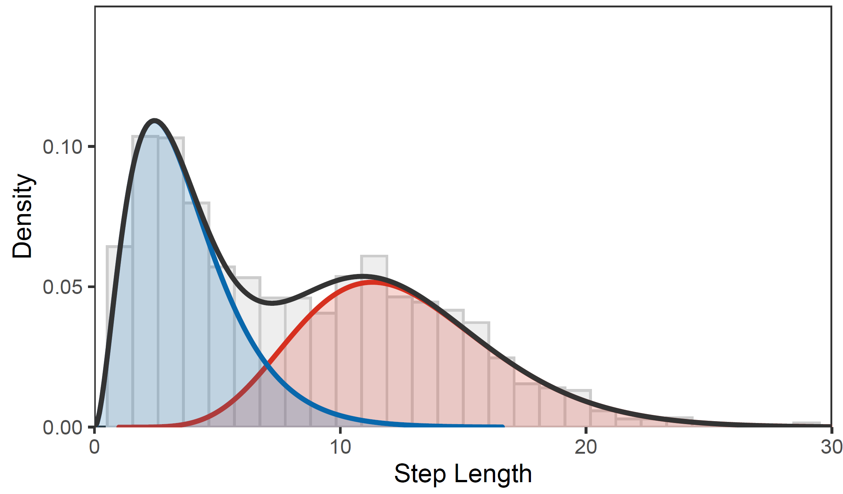
Movement modelling
Home range estimation
Path reconstruction
Habitat & resource selection
Behaviour segmentation
Movement parameter estimation

Slide 4
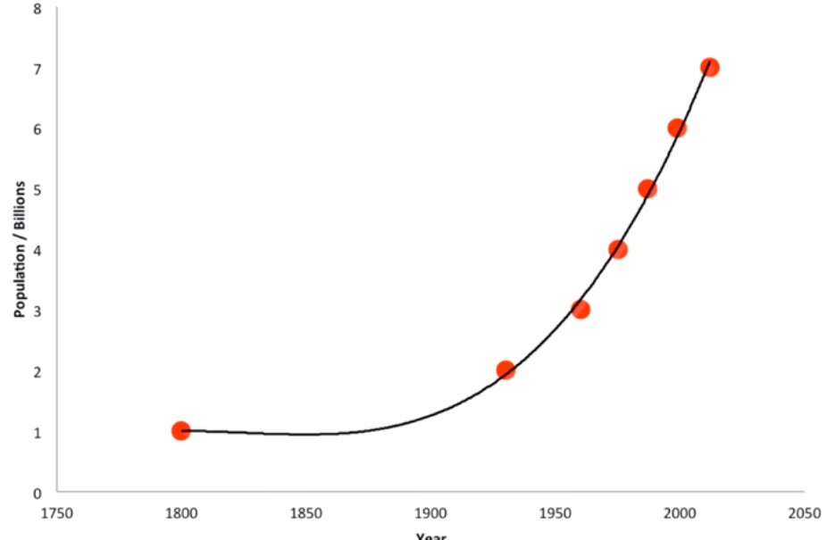
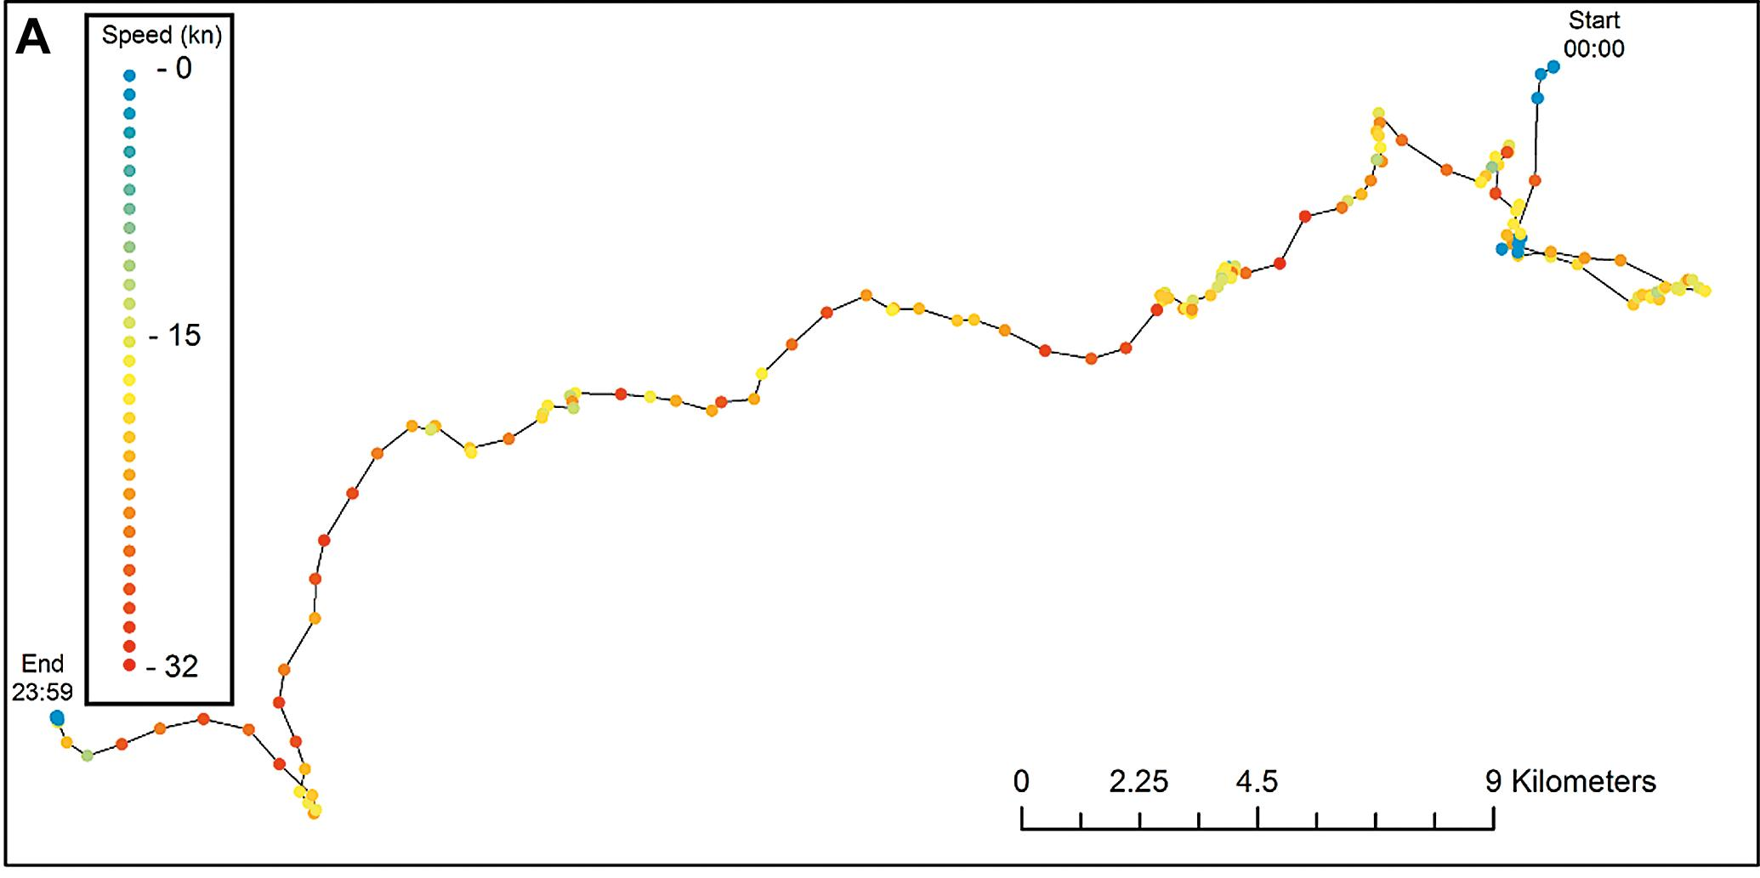


Hidden Markov models: Motivation
Underlying biological process is hidden
Observation is conditional on latent process
Population size vs sample
Behaviour state vs location data
Latent process is autocorrelated
State at one time depends on the previous time

Slide 5
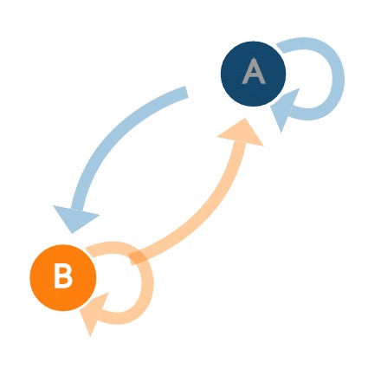
Hidden Markov models - Solution
Underlying biological process is hidden
Finite mixture model
Latent process is autocorrelated
Markov chain

Slide 6
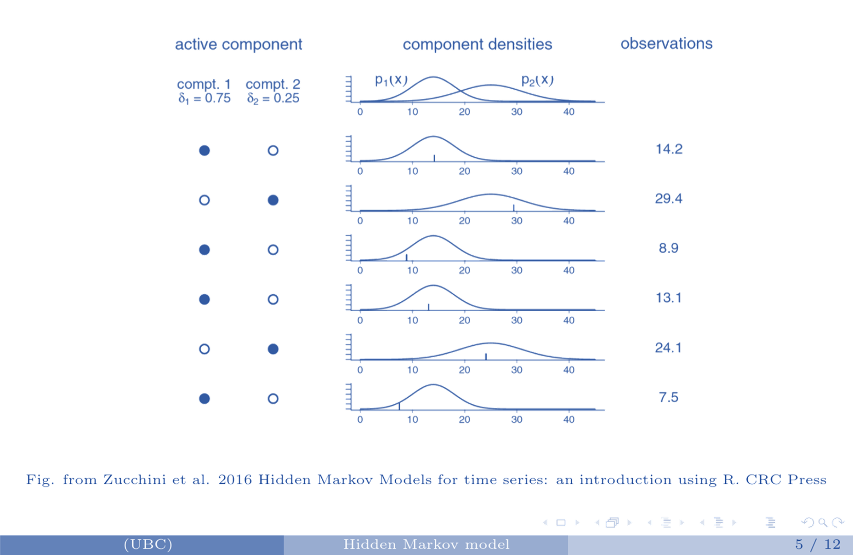

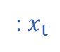
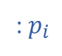
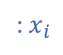
Finite mixture models
: $x_{i}$
: $p_{i}$
: $x_{t}$
$$X$$
Notes:
Procrasticide: Colour components by colour

Slide 7
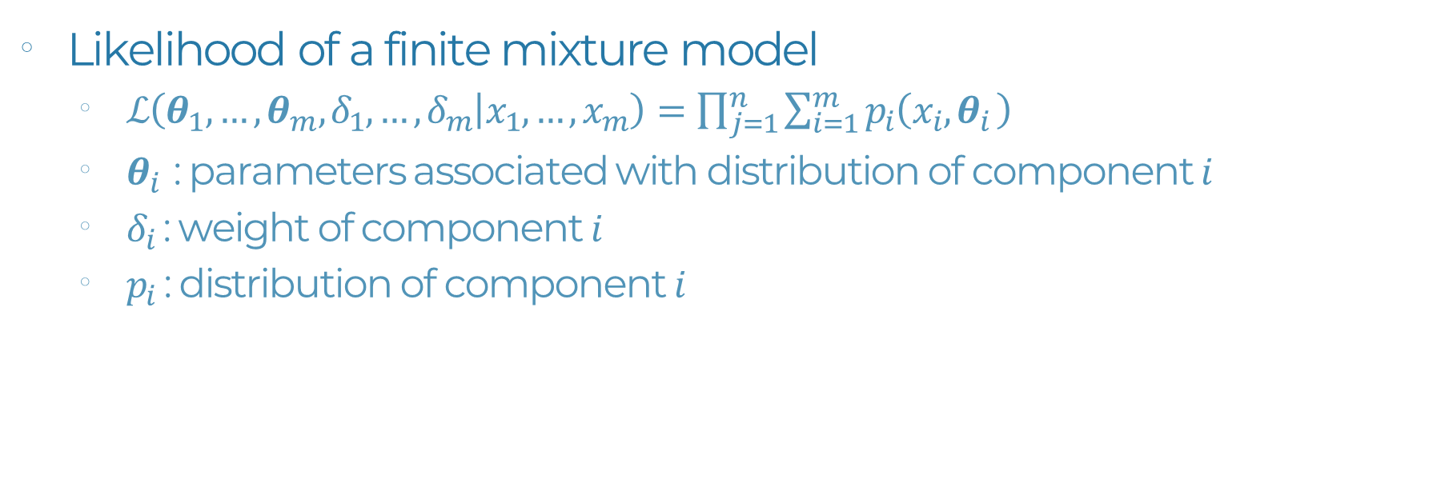
Finite mixture models
: $p_{i}$
: $x_{t}$
$$X$$
Likelihood of a finite mixture model
$ℒ\left(θ_{1},…,θ_{m},δ_{1},…,δ_{m} | x_{1},…,x_{m}\right)=\prod_{j=1}^{n}{\sum_{i=1}^{m}{p_{i}\left(x_{i},θ_{i }\right)}}$
$θ_{i }$: parameters associated with distribution of component $i$
$δ_{i}$: weight of component $i$
$p_{i}$: distribution of component $i$
Notes:
Procrasticide: Animate likelihood equation

Slide 8
Hidden Markov models - Solution
Underlying biological process is hidden
Finite mixture model
Latent process is autocorrelated
Markov chain

Slide 9

Markov chain
$$C_{t+1}$$
1
2

Slide 10
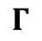
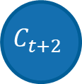
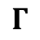
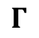
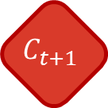
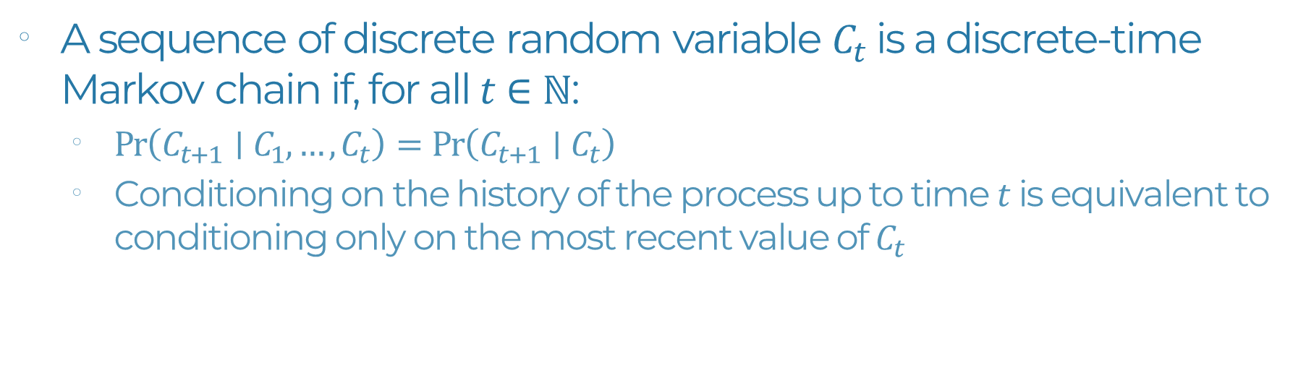
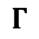

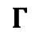

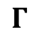

Markov chain
$$C_{t−2}$$
$$C_{t−1}$$
$$C_{t}$$
$$C_{t+1}$$
$$C_{t+2}$$
$$Γ$$
$$Γ$$
$$Γ$$
$$Γ$$
$$Γ$$
$$Γ$$
A sequence of discrete random variable $C_{t}$ is a discrete-time Markov chain if, for all $t∈ℕ$:
$Pr\left(C_{t+1}∣C_{1},…,C_{t}\right)=Pr\left(C_{t+1}∣C_{t}\right)$
Conditioning on the history of the process up to time $t$ is equivalent to conditioning only on the most recent value of $C_{t}$

Slide 11

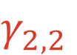
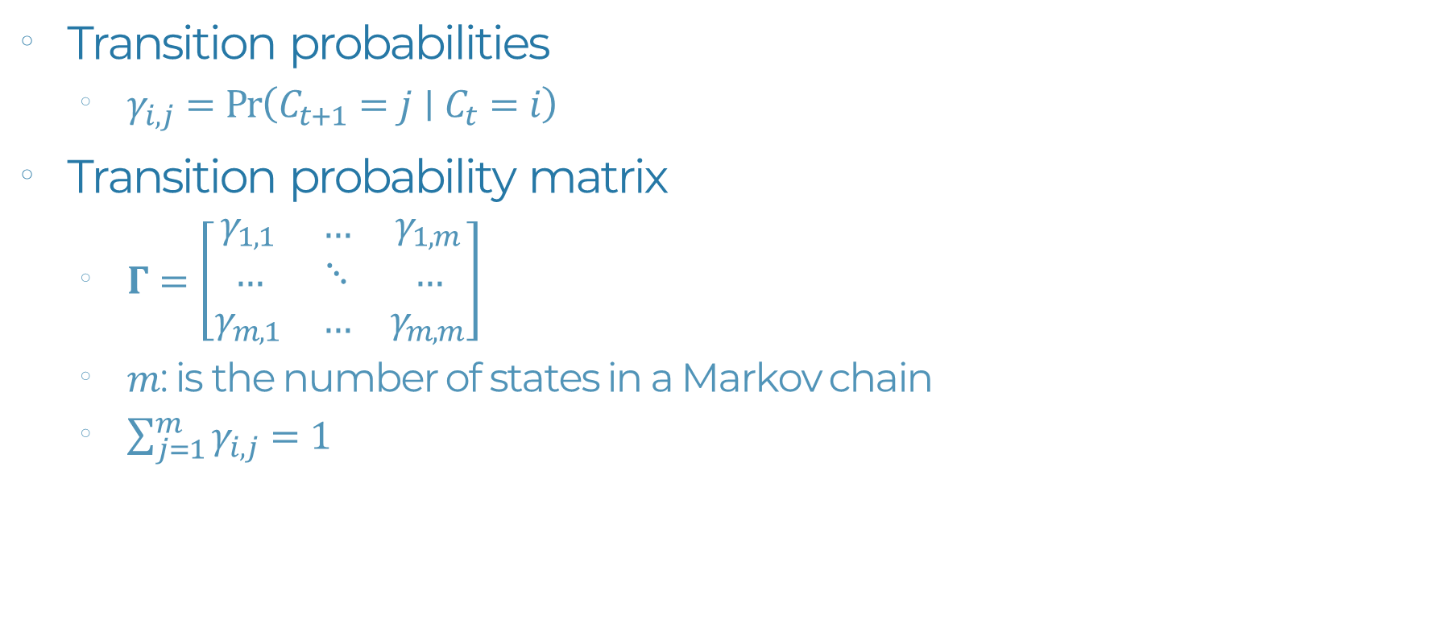
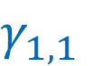
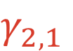
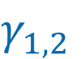
Markov chain: Key parameters
Transition probabilities
$γ_{i,j}=Pr\left(C_{t+1}=j∣C_{t}=i\right)$
Transition probability matrix
$Γ=\left[\begin{matrix}γ_{1,1} & … & γ_{1,m} \\ … & ⋱ & … \\ γ_{m,1} & … & γ_{m,m}\end{matrix}\right]$
$m$: is the number of states in a Markov chain
$\sum_{j=1}^{m}{γ_{i,j}}=1$
$$γ_{1,2}$$
$$C_{t+1}$$
1
2
$$γ_{1,1}$$
$$γ_{2,2}$$
$$γ_{2,1}$$

Slide 12
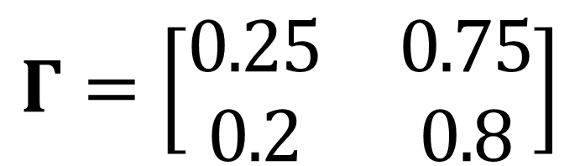
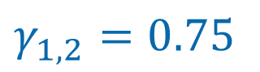
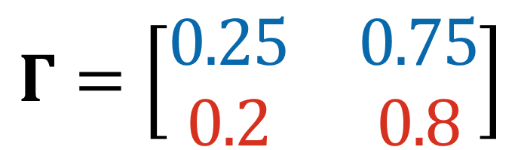
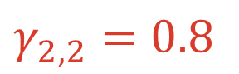
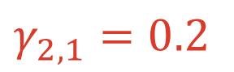
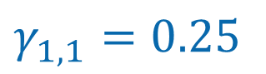
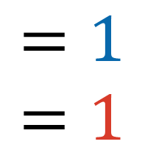
Markov chain : Transition probability
$$γ_{1,2}=0.75$$
1
2
$$γ_{1,1}=0.25$$
$$γ_{2,2}=0.8$$
$$γ_{2,1}=0.2$$
$$Γ=\left[\begin{matrix}0.25 & 0.75 \\ 0.2 & 0.8\end{matrix}\right]$$
$$\begin{matrix}=1 \\ =1\end{matrix}$$
$$Γ=\left[\begin{matrix}0.25 & 0.75 \\ 0.2 & 0.8\end{matrix}\right]$$

Slide 13
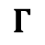
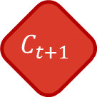
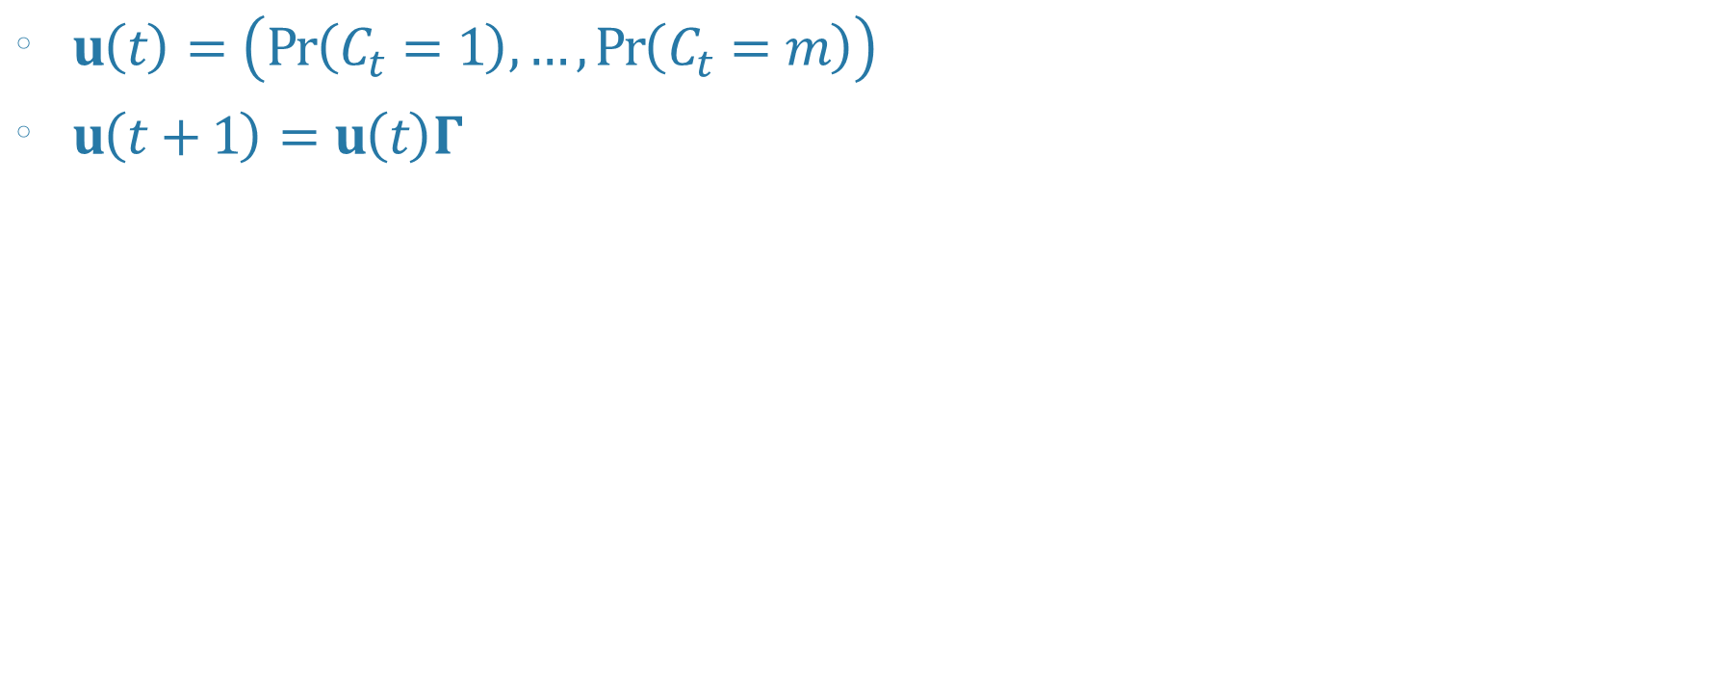
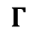

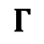

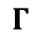

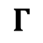
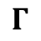
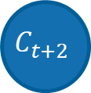
Markov chain : Unidirectional probabilities
$u\left(t\right)=\left(Pr\left(C_{t}=1\right),…,Pr\left(C_{t}=m\right)\right)$
$u\left(t+1\right)=u\left(t\right)Γ$
$$C_{t−2}$$
$$C_{t−1}$$
$$C_{t}$$
$$C_{t+1}$$
$$C_{t+2}$$
$$Γ$$
$$Γ$$
$$Γ$$
$$Γ$$
$$Γ$$
$$Γ$$
Notes:
If we define u(t) as a set of probabilities of being in of being in any given state at time t
Then the set of state probabilities at the next time step <μ(t+1)> can be obtained by simply multiplying by the transition probability matrix

Slide 14
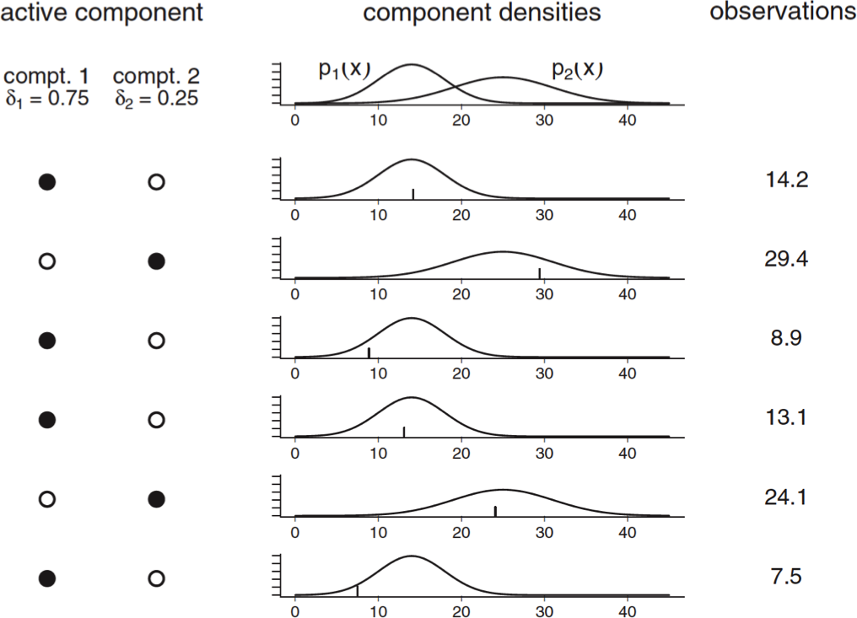
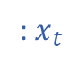
Hidden Markov model
Mixture model where the weights are defined by a Markov chain
: $x_{t}$

Slide 15
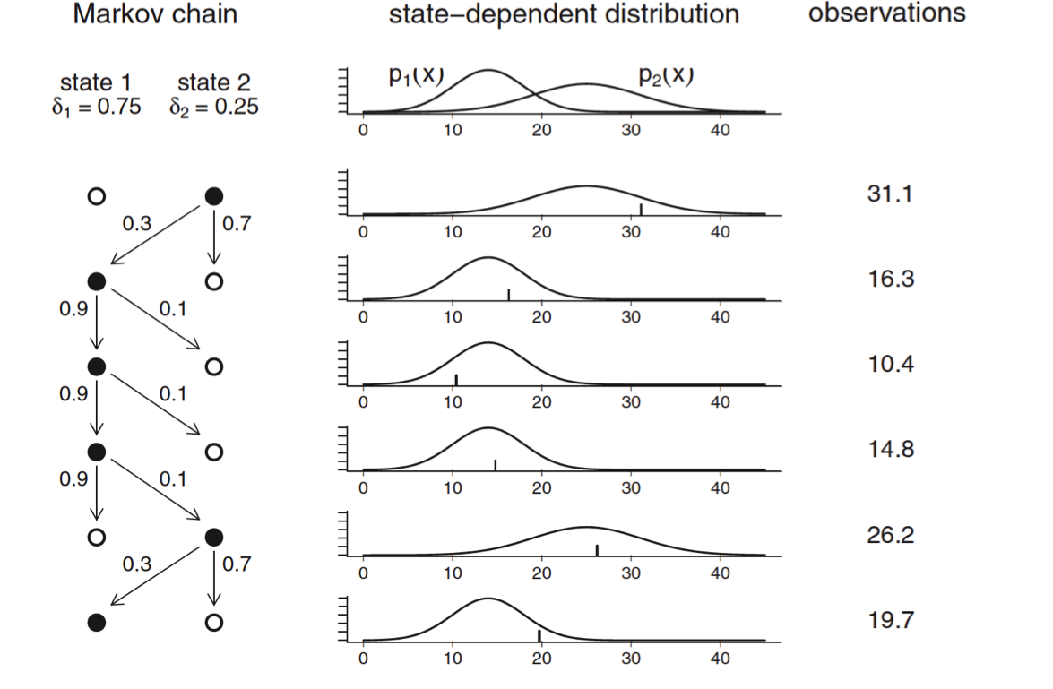

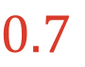
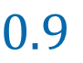
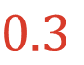
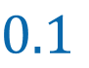
Hidden Markov model
Mixture model where the weights are defined by a Markov chain
: $x_{t}$
$$0.1$$
$$C_{t+1}$$
1
2
$$0.9$$
$$0.7$$
$$0.3$$

Slide 16

Hidden Markov model
State probability: $Pr\left(C_{t}∣C_{t−1}\right)$
Emission probability: $Pr\left(x_{t}∣C_{t}\right)$
State dependent distribution: $p_{i}\left(x\right)=Pr\left(X_{t}=x∣C_{t}=i\right)$
$P(x)=\left[\begin{matrix}p_{1}(x) & … & 0 \\ … & ⋱ & … \\ 0 & … & p_{m}(x)\end{matrix}\right]$
$u\left(t\right)=\left(Pr\left(C_{t}=1\right),…,Pr\left(C_{t}=m\right)\right)$
$Pr\left(X_{t}=x\right)=u\left(t\right)P\left(x\right)1^{′}$

Slide 17

Hidden Markov model: Likelihood
$ℒ=∏_{i=1}^{n} P(x)$
Does NOT work because $Pr\left(X_{t}=x\right)$ is dependent on $Pr\left(X_{t−1}=x\right)$
$ℒ=δ\left(x_{1}\right)ΓP\left(x_{2}\right)…Γ\left(x_{n}\right)1^{′}$
$δ=μ(1)$

Slide 18










Behaviour detection
Markov chain:
Hidden state:
$$P\left(x_{t−2}\right)$$
$$P\left(x_{t−1}\right)$$
$$P\left(x_{t}\right)$$
$$P\left(x_{t+1}\right)$$
$$P\left(x_{t+2}\right)$$
$$l_{t−2}$$
$${\text{ϕ}}_{t−2}$$
$$l_{t−1}$$
$${\text{ϕ}}_{t−1}$$
$$l_{t}$$
$${\text{ϕ}}_{t}$$
$$l_{t+1}$$
$${\text{ϕ}}_{t+1}$$
$$l_{t+2}$$
$${\text{ϕ}}_{t+2}$$
Observation:
ϕ
l
Notes:
One of the most powerful tools ecologists have for identifying multiple behaviours from time series data is HMM
The basic premise is as follows. The true behaviours of an animal are discrete states that are hidden and that we do not observe.
However, through methods like remote tracking, we do obtain a sequence of observation data, typically location data, from which we can derive data streams such as SL & TA. which we assume have some Probabilistic relationship With the hidden state.
We also assume that the hidden states are a Markov process, in which the probability of entering a state depends only on the previous state.

Slide 19






Behaviour and Habitat Selection
Available versus Use
Behaviour
Notes:
More recently, there has been a push for identifying and using behaviours of interest from the track

Slide 20



Slide 21
Behaviour detection
Hidden Markov Models
Hidden state:
Observation:
ϕ
l
Markov chain:
Notes:
One of the most powerful tools ecologists have for identifying multiple behaviours from time series data is HMM
The basic premise is as follows. The true behaviours of an animal are discrete states that are hidden and that we do not observe.
However, through methods like remote tracking, we do obtain a sequence of observation data, typically location data, from which we can derive data streams such as SL & TA. which we assume have some Probabilistic relationship With the hidden state.
We also assume that the hidden states are a Markov process, in which the probability of entering a state depends only on the previous state.

Slide 22

ϕ_{t}
l_{t}
μ ^{(l)} = 2.4, σ ^{(l)} = 1.4
μ ^{(l)} = 8, σ ^{(l)} = 2.5
μ ^{(ϕ)} = 0, κ ^{(ϕ)} = 0.05
μ ^{(ϕ)} = 0, κ ^{(ϕ)} = 2

Slide 23


Wind & Sea Ice Drift
20°

Slide 24
HMM & Covariates
l_{t-1}
π
0
-π
μ_{t}^{(ϕ)} = f(ψ_{t})
ϕ_{t}
μ_{t}^{(ϕ)}
μ_{t}^{(ϕ)} = 0
ψ_{t}
-π 0 π
ψ_{t}
Notes:
One of the big challenges is to identify different behavioural states, especially when only few data-streams are available. One relatively recent strategy is to look at the movement relative to some external factor. For instance, movement relative to drift or relative to some activity centre could contain information on the behaviour of the animal. The goald for my first chapter is to incorporate this relative movement into HMMs to identify additional behaviours.

Slide 25
HMM & Covariates
Habitat Data:
Markov chain:
Notes:
Another option is to model the transition probabilities based on environmental data. where, for ex. some habitats may increase the TP to one state and other habitats may increase the transition to other states.

